Slide 1
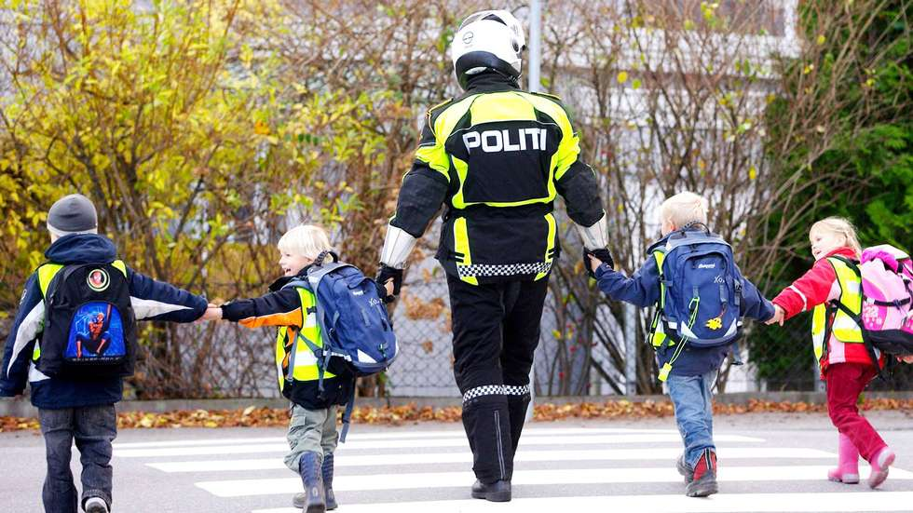
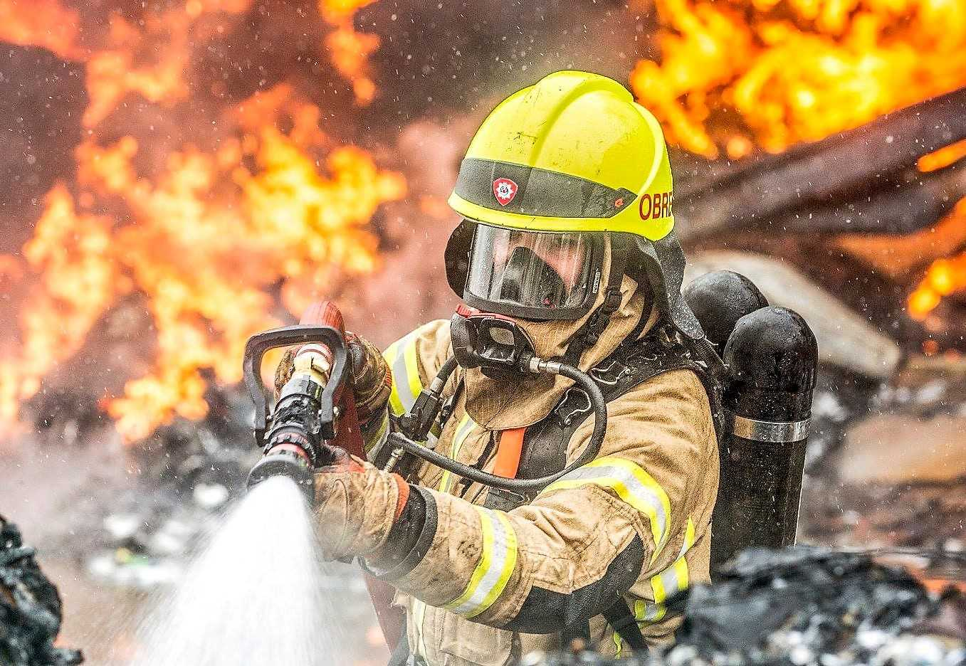
How the services are organised

Slide 2
The Norwegian Police Service
The Ministry of Justice and Public Security
Central National Police Directorate
Seven special agencies
Twelve police districts
16,000 employees, of which 8,000 are police officers

Slide 3
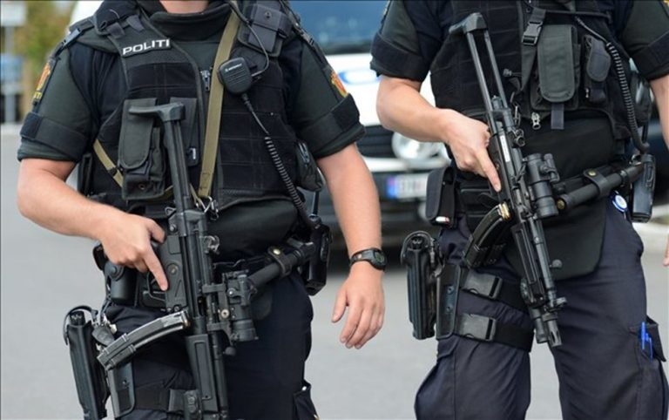
Norwegian police do not carry firearms. Weapons are kept and locked in patrol cars.

Slide 4
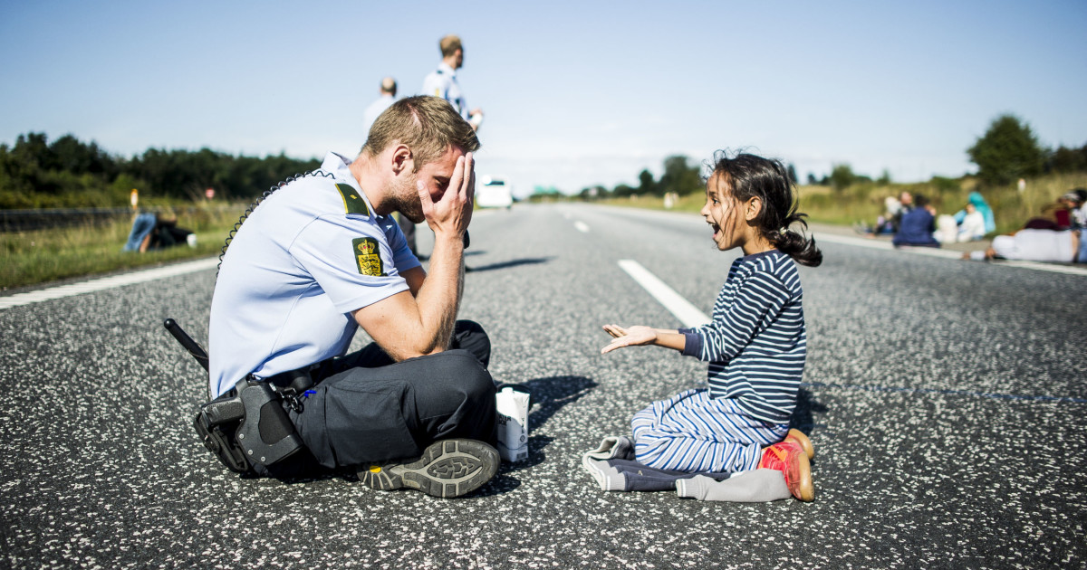
Border guards
The police serve as border guards for the outer border of the Schengen
Photo: Michael Drost-Hansen, Jyllands-Posten
Notes:
Photo: Danish police man plays with Syrian girl, refugee, 2015

Slide 5
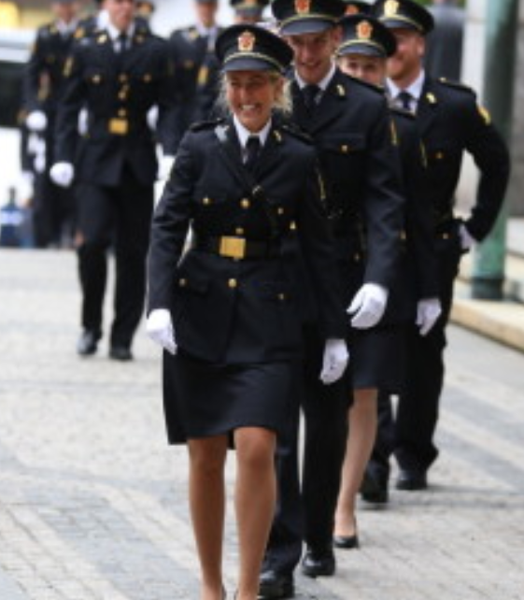
Police officer training is a three-year bachelor’s degree, where the first and third year take place at the college and the second year is on-the-ground training in police districts

Slide 6
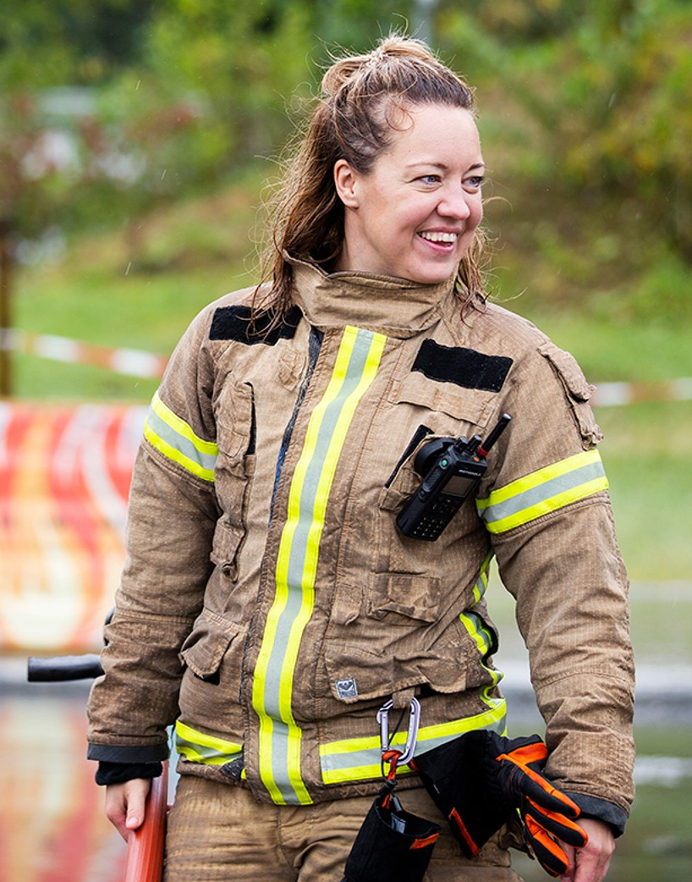
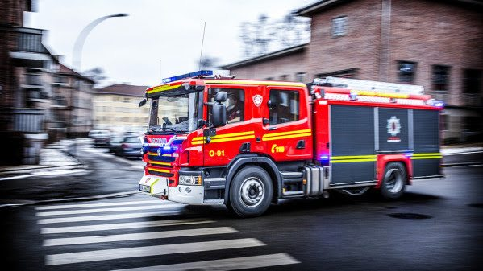
The Fire service

Slide 7
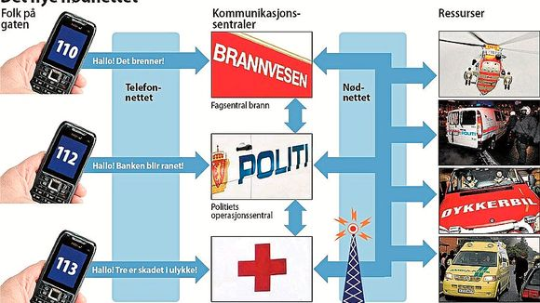
Laws and regulations under
Ministry of Justice
The Norwegian Directorate for Civil Protection (DSB).
DSB's overall task is maintaining a complete overview of various risks and vulnerability in general.
DSB’s responsibilities cover local, regional and national preparedness and emergency planning, fire safety, electrical safety, handling and transport of hazardous substances, as well as product and consumer safety.

Slide 8
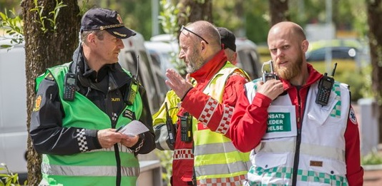
Norwegian Emergency Public Safety Network
A separate digital radio network, built specifically for rescue and emergency users
The core users of the network are the three emergency services: fire, police and health
Owned and managed by DSB
Notes:
Nødnett

Slide 9
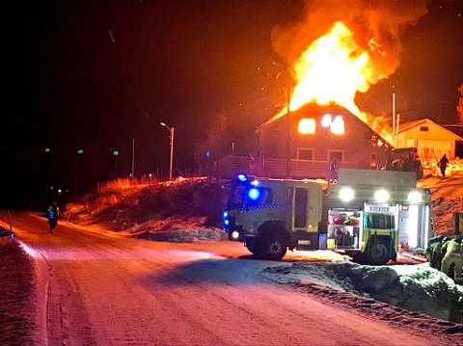
Fire department
A municipal responsibility, but is under strict national regulation regarding size, organisation and response time.
A municipal council can have its own fire department, or
  collaboration between several municipalities
  as part of an inter-municipal company fire department or a host fire department system
Notes:
Main principles: Number of inhabitants Risk assessment

Slide 10
There are around 3000 full-time emergency response personnel and about 8000 working part time, on-call emergency personnel in Norway.
Notes:
There is no voluntary firefighter. Everyone is employed and covered by public law.

Slide 11
Ambulance and customs
Ambulance services
Customs
Ministry of Health
Administered by the hospital
A governmental responsibility
Ministry of Finance
Government agency
Responsible for protecting society against illegal importation and exportation of goods
To ensure government revenues by correct and timely payment of duties and taxes
Notes:
The hospitals and the ambulance service were previously a municipal responsibility, but a hospital reform January 2002 transferred the ownership of all public hospitals, psychiatric institutions, ambulance services, substance abuse services under the specialist health service and more to the be a governmental responsibility.

Slide 12
History of unions
The Fire Service in Oslo started the first union in May 1894
Over the next two decades, the other fire departments formed their own unions. In 1920 these were united with other municipal associations in what is now “Fagforbundet” (Norwegian Union of Municipal and General Employees)
The Police started their first union in 1894
They had several organisations, but are now united in: The Norwegian Police Union (Politiets Fellesforbund)
Notes:
Many of the ambulance personnel are members of NUMGE

Slide 13
