Slide 1
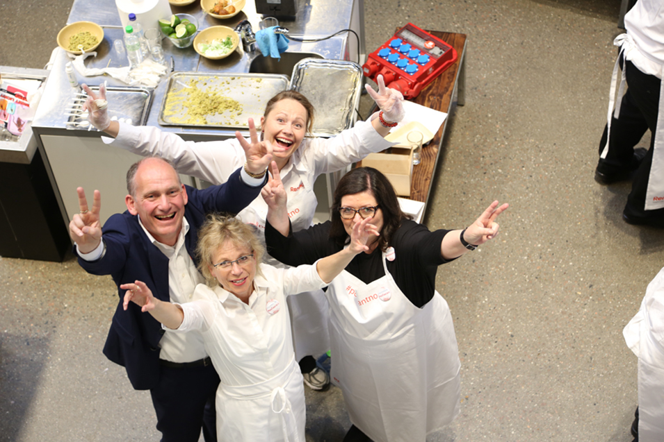


The Norwegian model of social packages

Slide 2
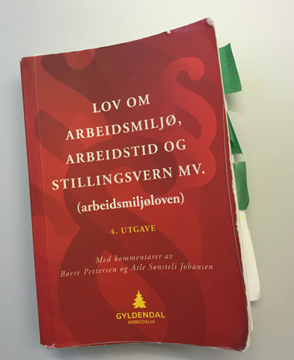
The Working Environment Act - part of the social package
Ensures that many social benefits apply to all employees
Many of the same rights as in the collective agreements
Notes:
Because the labor movement and trade unions have had a strong commitment to developing the Work Environment Act, we have also made sure that social welfare is basic. This ensures that many social benefits apply to all employees.
We will find many of the same rights in the collective agreement, but with even better conditions

Slide 3
Systematic health, safety and environment work
Obligation to elect safety representatives and to establish working evironment committees
Duty to adapt work for employees with reduced capacity to work
Ensures equality between all genders
Employers have to undergo training and provide training for employees on health, safety and environment work
Notes:
Requirements regarding arrangement, participation and development, psychosocial working environment, the physical working environment,
If you become permanently ill or otherwise injured, the employer is obliged to try to find or adapt the work for you.
All kinds of discrimination are prohibited. Religious, sexuality, race etc.
The safety representative's right to halt dangerous work
The rights to costs, training, etc.
The committees has equal number from employer and employee. The employer and employee chair the committee every other year.

Slide 4
General rights
Work schedule
Normal working hours
Overtime
Daily and weekly off-duty time
Work on Sundays
Night work
Exceptions
Notes:
Maximum and minimum rules
Police and fire have several exceptions due to the nature of the service

Slide 5
Entitlement to leave of absence:
Pregnancy leave
Care for a child
Maternity leave
Parental leave, 12 months in total for both parents
Time off for nursing mothers, child's or childminder's sickness, up to 10 days
Care for close family

Slide 6

Collective agreements – part of the social package
Many of the rights we have by law are strengthened in these agreements, for example:
  Rights for leave. By law it can be without pay, but with full pay in the collective agreement
  The law requires minimum 40% surcharge for overtime, while in the agreement we have 50 and 100%
  Payments for Sundays and night-shifts
  Insurance covered by the employer

Slide 7
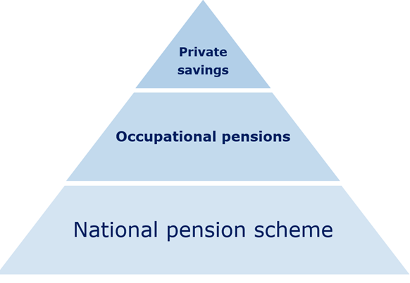
Pension
Every one has the right to a basic pension
The public and private sectors have their own pension schemes and agreements
In the public sector the pension is divided into three parts:
  The state pension that every body receives
  An additional occupational pension scheme (contributions covered by the worker and the employer)
  Personal account pensions (optional)
Notes:
Private pension schemes are mandatory (2 percent minimum)

Slide 8
Special agreements for different groups
Firefighters have their own agreements. Neither EU directives nor national law allow 24-hour shifts.
Many firefighters are "on call" and or work part-time. This is regulated by the special agreement.

Slide 9
Union members’ benefits
The bank and insurance company, SpareBank1, is partly owned by The Norwegian Confederation of Trade Unions (LO Norway).
Among other benefits, this gives members access to a collective home insurance scheme, rated as the best value home insurance on the Norwegian market.

Slide 10

Training for members
Courses and conferences
Vocational education, further education and education of shop stewards

Slide 11
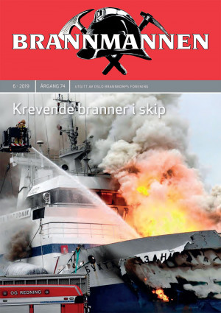
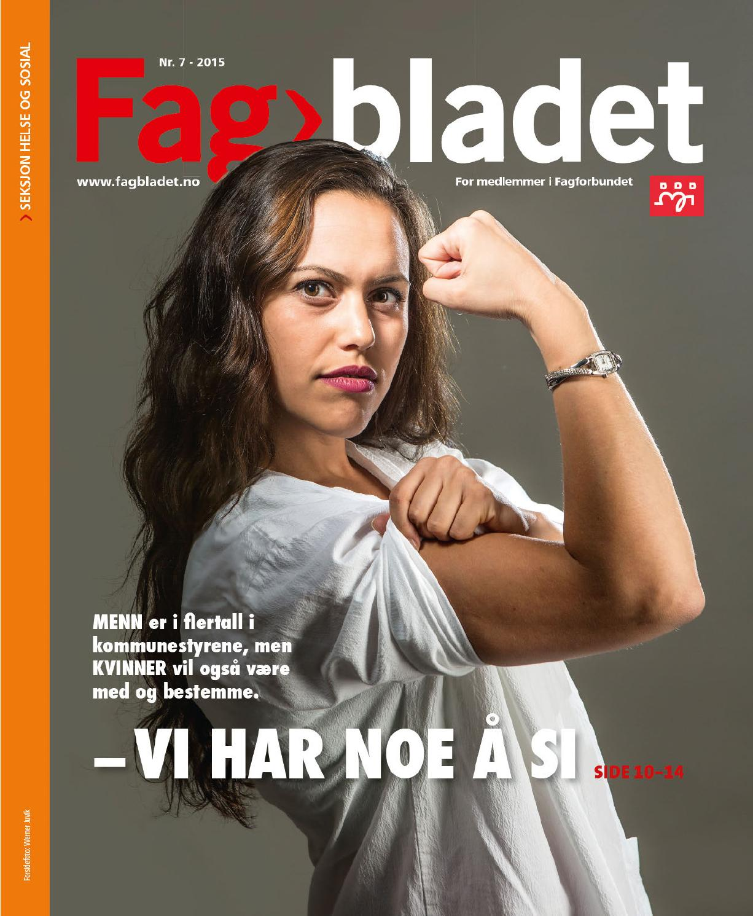
Notes:
We also have member magazines and special magazines

